Slide 1
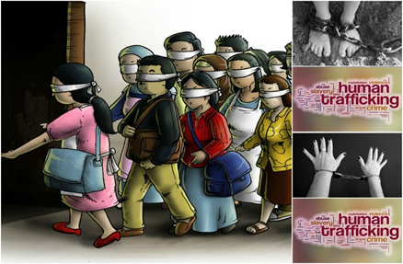
COMBAT Trafficking in Human Beings
SLIDES SUPPORTING THE REFERENCE GUIDE
FOR SENIOR HOTEL MANAGERS
This project has been funded with support from the European Commission. This publication reflects the views only of the authors, and the European Commission cannot be held responsible for any use which may be made of the information contained therein.

Slide 2
COMBAT THB: The Framework
Why targeting THB?
One of the most profitable types of crime today after arms and drugs trading
An approx. US$ 150 billion business per year
2/3 of it from commercial sexual exploitation, 1/3 from forced labour exploitation
Who?
A team of 3 universities with established reputation in hospitality joined forces with a CSO with track record in the field of human trafficking prevention and assistance
Oxford Brookes University (leading partner), University of West London, Lapland Institute for Applied Science, Rațiu Foundation for Democracy

Slide 3
COMBAT THB: The Framework
Trafficking in human beings (THB) is a serious and dramatic phenomenon. Although a solid legal and policy framework has been established, THB is assuming worrying dimensions to the point of being considered as the “slavery of our times”
Recent statistics by the International Labour Organization (2012) show that the global social problem of THB is rising in Western Europe. A significant proportion of trafficking is undertaken through travel and tourism businesses which, by their nature, facilitate the movement and accommodation of traffickers and their victims. There is also evidence that tourism businesses are used for sexual and labour exploitation of trafficking victims

Slide 4
Generic info on human trafficking applicable to all levels
As a criminal activity, trafficking in human beings (THB) generates US$ 150 billion in revenue per year. Two thirds of this amount comes from commercial sexual exploitation, while the other third results from forced labour exploitation. With the hospitality industry in the EU employing some 9.5 million workers, spread out across 1.7 million enterprises, traffickers and organised criminals see an opportunity to exploit a sector perceived to be largely defenceless to, sometimes even complicit in, their activities
The nature and necessities of THB - the requirement for continuous movement, temporary accommodation, supply of low cost products and services and the privacy and anonymity offered to guests - place hospitality businesses in a high level of exposure to this criminal activity. At the same time they are also in a unique position to identify and combat it
The COMBAT training toolkit is designed to be a preventive and practical, step-by-step guide for hotel organisations to proactively fight THB. It seeks to help the prevention of trafficking in human beings in your business, to mitigate your exposure to this criminal activity and, most importantly, enable your organisation to assist the reintegration of trafficking survivors back into society
The COMBAT training toolkit is developed for three levels in tourism process (three lines of defence approach) that are operative, management and corporate levels. In this way the toolkit provides comprehensive and coherent approach that covers all main aspects in tackling against human trafficking!
See: http://www.hotrec.eu/about-us/facts-figures.aspx

Slide 5
Generic info on human trafficking applicable to all levels WHAT IS HUMAN TRAFFICKING?
The Directive 2011/36/EU of the European Union defines trafficking of human beings (THB) as:
“The recruitment, transportation, transfer, harbouring or reception of persons, including the exchange or transfer of control over those persons, by means of the threat or use of force or other forms of coercion, of abduction, of fraud, of deception, of the abuse of power or of a position of vulnerability or of the giving or receiving of payments or benefits to achieve the consent of a person having control over another person, for the purpose of exploitation”
The definition is contained in Article 2 of Directive 2011/36/EU entitled ‘Offences concerning trafficking in human beings’ and actually states that Member States are under an obligation to take the necessary measures to ensure that [the above listed] intentional acts are punishable. This definition here contained coincides with what is provided by Article 4 of the Council of Europe Convention on Action against Human Trafficking 2005
Note: Human trafficking and human smuggling are not the same phenomenon. They could be two aspects of the same offence or alternative crimes. One of the key differences between human trafficking and smuggling is that the latter always involves the illegal crossing of national borders

Slide 6
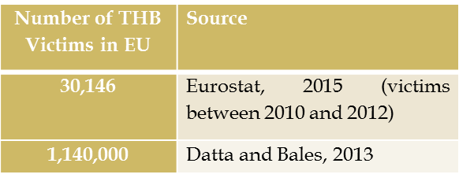
Generic info on human trafficking applicable to all levels EXTENT OF THE PROBLEM WITHIN EU
Determining the extent of (THB) is not easy for a number of reasons.
However, the problem is very wide and you may easily face it in your professional career wherever you operate!
Number of THB Victims Globally | Source
40,177 | UNODC, 2014 (victims between 2010-2012)
30,000,000 | Crane, 2013
21,000,000 | ILO, 2012

Slide 7
Generic info on human trafficking applicable to all levels FACTS AND FIGURES

Slide 8
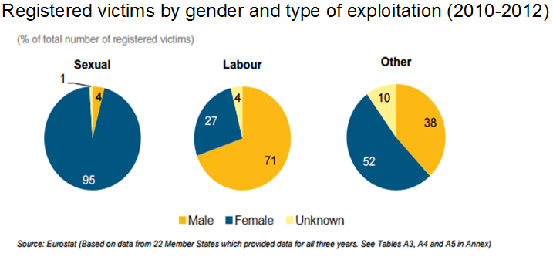
Generic info on human trafficking applicable to all levels FACTS AND FIGURES

Slide 9
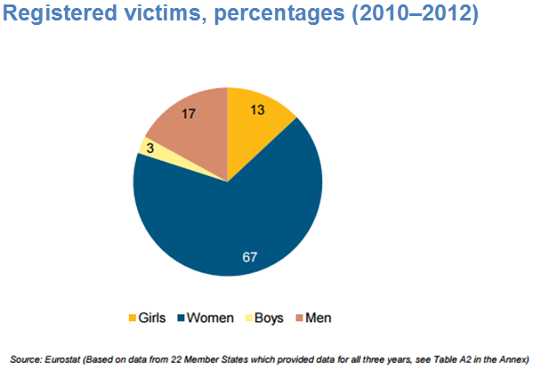
Generic info on human trafficking applicable to all levels FACTS AND FIGURES

Slide 10
Case of Karla
Karla’s Story:
I thought I was lucky to have been promised the opportunity to work in a smart city centre hotel in another part of the country. I got the job offer through a distant relative who took me to the city and introduced me to a group of ‘her’ business associates. They were very kind at first and I was excited. I soon realised that things were not actually what was promised. At the beginning, they helped me with some basic training and to apply for a job in the reservation’s department of a hotel. They also made sure I was presentable so that I could go for an interview. With the CV they provided me, I got the job. The hotel took my address from the CV. It wasn’t my real address, but I guess no one from the hotel ever checked. I also provided the hotel with details of a bank account that my wages were paid into. I wasn’t able to access that account to get hold of any money, but I guess nobody checked for that either. Who would give their employer a bank account that they cannot access? At least the hotel provided meals during my shifts so I didn’t go hungry when I was working. At work, I followed my orders from the traffickers. I began to change non-commissionable room reservations into ones booked by the traffickers ‘fake’ travel agency so that the commission could be paid directly into their bank account. However many reservations I changed, the traffickers always wanted more. I started to volunteer to work extra shifts, so I could change more reservations. I knew it was risky so I tried to keep to myself.
(continued…)

Slide 11
Case of Karla
I didn’t go to any staff social functions but volunteered to cover other employees’ shifts instead. When colleagues offered me a lift home after work, it was easy to have them drop me off on a street corner so I didn’t have to give them a street address. I don’t know why I kept doing what I was doing. I felt trapped and had nowhere else to go. I was afraid of what the traffickers might do to me. Their plan was to have me apply for the same job in a bigger and better hotel as soon as one became available so they could make more money on each reservation I changed. It was almost a relief when the hotel discovered what I was doing and called the police. When I was arrested, the police were really only interested in the crime I committed, not my story. They kept me in jail though, as I had no fixed address or any means of support. At least I felt safe from the traffickers there. It was only when the case went to court that my true story came out and with it, the story of several others, like me. It seems that these traffickers had quite a big business going across the city. We were their hidden employees really, working hard for them while employed by the hotels; working hard to cheat the local hotels and feed funds into the traffickers’ bank accounts.

Slide 12
Generic info on human trafficking applicable to all levels FACTS AND FIGURES
In countries around the globe, there has been a growing focus on the use of hotels as vehicles for THB, particularly for the purposes of child sexual exploitation (CSE). More and more governments are recognising that hotels may be intentional or unintentional vehicles or conduits for traffickers and their victims and call for their support and involvement in the fight against THB. In some countries therefore, the relevance of business or corporate culpability is recognised.
Regardless of whether hotels:
Are unknowing or unwitting participants,
Adopt a ‘head in the sand’ approach and ignore trafficking signs, or
Are willing participants who may or may not share in the trafficking proceeds,
US Department of State (2015). Trafficking in Persons Report (July). [Available online: http://www.state.gov/documents/organization/245365.pdf, accessed 14 April 2016].

Slide 13
Generic info on human trafficking applicable to all levels FACTS AND FIGURES

Slide 14
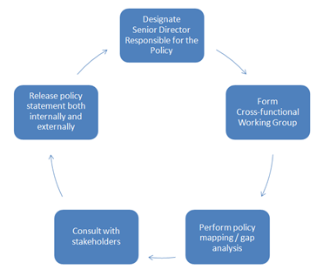
Human trafficking training for management level stakeholders
Steps for developing an anti-THB policy statement and programme (explain here!)

Slide 15
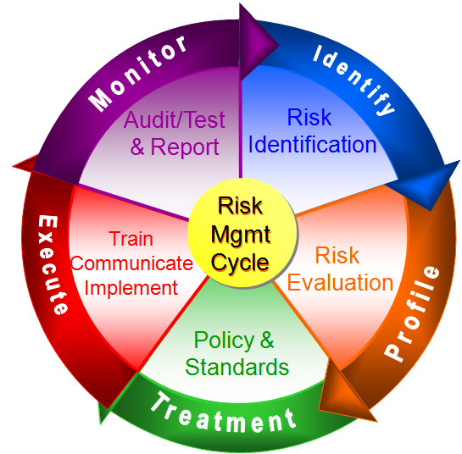
Human trafficking training for management level stakeholders
Risk management cycle (explain here!)

Slide 16
Human trafficking training for management level stakeholders
Risk based approach: THB as a risk:
Risk is the probability of damage, injury, liability, loss, or any other negative occurrence that is caused by external or internal vulnerabilities, and that may be avoided through pre-emptive action. It is the ‘cumulative effect of the probability of uncertain occurrences that may positively or negatively affect business objectives’. Risks are inevitable as long as vulnerabilities exist in the organisation and its environment. (Ward 2008: 353)

Slide 17
Human trafficking training for management level stakeholders
Risk based approach:
By viewing THB as a risk to which hotel organisations are exposed, they can group their properties into high, medium or low-risk categories, based on variables such as location, size, service-level, target market, etc. all of which may increase or decrease the perceived risk of THB. Hotel properties can be evaluated on a case-by-case basis, with risk assessments carried out depending on the level of detail needed. The depth of controls to be implemented will depend on how big the THB risk is perceived to be.

Slide 18
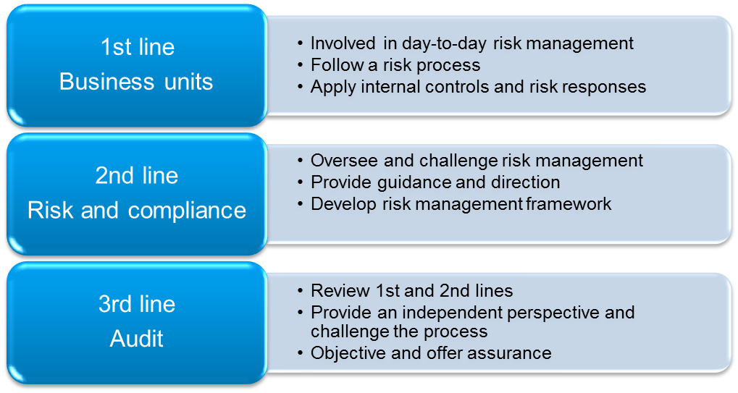
Human trafficking training for management level stakeholders
Three lines of defence (explain here!)

Slide 19
Human trafficking training for management level stakeholders
Risk assessment process:
Risk identification is the stage which aims to identify, characterise and -where appropriate- quantify a set of risks
Risk evaluation is the stage which seeks to evaluate the significance of those risks, with regards to their likelihood (probability) of occurrence and their potential impact on the organisation

Slide 20
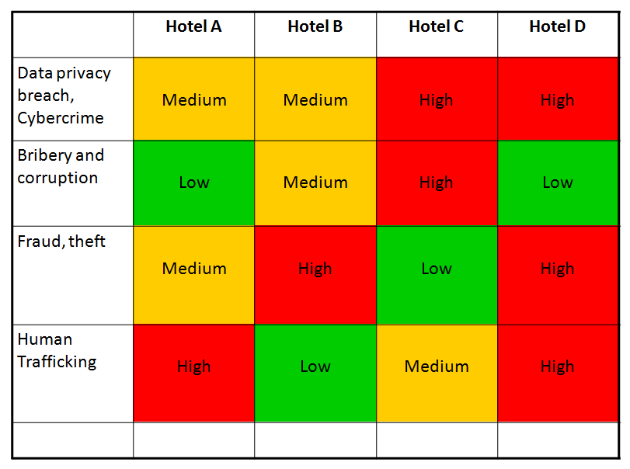
Human trafficking training for management level stakeholders
The evaluation may be a sophisticated quantitative or a less sophisticated qualitative one. In the end of the process, however, it will produce a “Heat Map” which may look like the one in the following Figure:

Slide 21
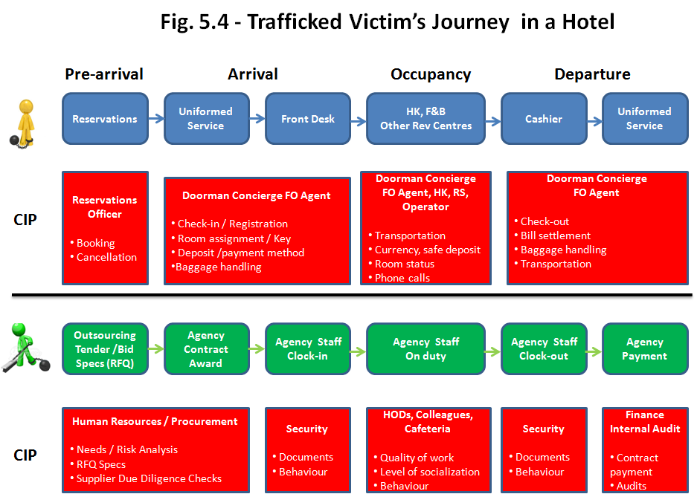
Human trafficking training for management level stakeholders
A further useful step in order to identify possible vulnerabilities is to look at where THB interfaces with the hotel front- and back-of-the house and the possible journeys of trafficked victims within a hotel.

Slide 22
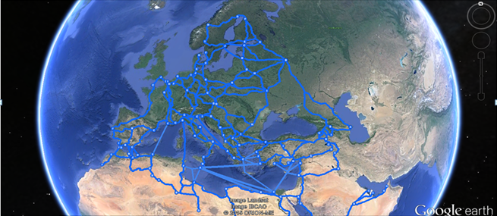
Human trafficking training for management level stakeholders
Trafficking Routes: EU

Slide 23
Case of Luka
Luka’s Story:
I was 19 when first heard of the opportunity to come to the UK to work in the agricultural sector. I already had lots of experience of working on my family’s farm in Lithuania. I had been brought up from a very early age to help out in looking after the livestock on the farm; mainly cattle and sheep. I thought that working abroad would enable me to send some money back to me parents, they were struggling to make ends meet on the farm, and I could save up to have my own farm one day.
I spoke to a friend of mine who said that an agency in Vilnius could secure me a job in return for paying them a percentage fee out of my wages. I applied and was told to turn up in the capital city in two days’ time to be provided with a work visa and plane ticket. What an adventure! I was astonished, therefore, to find myself joining 30 other men one cold morning in October on a rickety bus that would take us eventually to the North of England. It was a long journey, but we finally arrived at a very large egg farm. This is where things went downhill! This farm in Northumberland was not the only place where all 30 of us worked. We were driven literally around the whole of the UK, changing location sometimes after a few days, sometimes after a few weeks. We worked back-to-back eight-hour shifts for days and days at a time.
(continued…)

Slide 24
Case of Luka
Working as egg catchers, the conditions were often dangerous. I thought I would be working alongside nice farming folk like my parents but instead we were assaulted and abused by the Lithuanian supervisors.
These were not nice people; they often didn’t let us sleep or take toilet breaks and repeatedly withheld payment from us. I say ‘payment’ but really we got a pittance and were often told that if we didn’t continue to work our families would suffer back home. They kept our passports and said that the majority of our wages were going back to the agency to pay for our passage over to the UK and the opportunity of work. Some opportunity, it was torture! They even used fighting dogs to intimidate us and to get us to stay in the horrible farm outbuildings when not working where the mattresses on the floor were riddled with bedbugs. We were sometimes given nothing to eat so we had to pilfer eggs and were forced to eat them raw.
Just think how surprised I was when one day I found out that the company we worked for supplied the free-range eggs, at a low cost, we were collecting to fast-food chains and major supermarket chains.

Slide 25
Take part to code of conducts!
Research also suggests that there has been no ‘bad press’ reported for companies that proactively sign up to initiatives such as the Code of Conduct for the Protection of Children from Sexual Exploitation. In fact, those companies who have signed up to the Code have received positive press and improved morale amongst staff members. Carlson, the first hotel group to sign the Code in 2004, does admit that negative publicity was a concern prior to signature, but in reality they received positive publicity and support from customers and other stakeholders
CSR News (2004). Carlson Hotels Worldwide Partners with World Childhood Foundation to Help End Exploitation of Children. [Available online: http://www.csrwire.com/press_releases/20412-Carlson-Hotels-Worldwide-Partners-With-World-Childhood-Foundation-To-Help-End-Exploitation-Of-Children, accessed 14 April 2016]

Slide 26
Human trafficking training for management level stakeholders
Why is the hotel industry vulnerable to THB?
Strategic
Organisational Culture
Technological
Operational
Employment Practices
Outsourcing Strategies

Slide 27
Human trafficking training for management level stakeholders
Why is it important to combat human trafficking hotel industry?
Legal
Ethical
Moral obligations
Extensive negative publicity
Business interruptions by law enforcement agencies or public protest
Potential criminal or civil lawsuits as identified above

Slide 28
Human trafficking training for management level stakeholders
The general approach to anti-THB training in a hotel organisation could be to:
Provide good quality, standard training on THB risks, awareness and reporting for all staff
Provide additional, more detailed anti-THB policies and standards training for staff in higher-risk functions (e.g., recruitment, procurement, etc.) and locations (e.g., those identified as in close proximity to those routes used by traffickers)
Ensure that staff responsible for training others have sufficient training themselves
Ensure that training offers practical examples of THB risk and covers relevant policies and standards
Test staff awareness of THB and understanding of relevant policies and use the results to assess individual training needs and the overall quality of the training
Maintain staff records setting out what training was completed and when
Provide refresher training (it should not be viewed as a ‘one-off’ event) and ensure that all training material is kept up-to-date with legislative changes, internal or external case law and sectoral or general best practice

Slide 29
Human trafficking training for management level stakeholders
Good practice in external reporting would be for the organisation to disclose:
How the organisation, its business and its supply chains are structured - to provide some useful context to the reader
What policies it has in place (reviewed or introduced) to combat THB - they may be stand-alone policies or elements relevant to THB in other existing policies, e.g. procurement or hiring standard operating procedures
How the ‘tone from the top’ is set
How the overall governance of the anti-THB programme is managed
How the business functions have been risk assessed for vulnerabilities to THB (this could include an assessment by region)
How direct (and indirect) supplier contracts have been reviewed
The due diligence process on new and existing strategic customer accounts and suppliers (to show a thorough understanding of who the company is dealing with and who is working for them, e.g. through supplier audits)
The metrics used to assess the effectiveness of the anti-THB programme – e.g. specific KPIs
Who has been trained and how )e.g. target audience, key employees trained, training offered to strategic customers and/or suppliers, range and forms of training, etc.)

Slide 30
Human trafficking training for management level stakeholders
Monitoring anti-THB-activities – why it is important?
An effective anti-THB programme must be able to work in practice. It is a key management responsibility to monitor its effectiveness in preventing and/or mitigating the risk of THB throughout the business functions of the organisation as they evolve with the changing environment
Reports for internal stakeholders may include:
Periodic updates for the Board on the status of implementation of the anti-THB programme
Reports summarising internal audit and/or compliance monitoring findings
Reports of any alleged or actual breaches and the scope and findings of any investigation

Slide 31
Why it is important to communicate about THB?
An enhanced level of awareness of front- and back-of-the-house THB risks amongst all employees;
Sensitivity to these risks across the organisation with effective monitoring and reporting of possible signals (red flags)
The ability of operational management to invoke the relevant incident management procedures, when appropriate

Slide 32
What champions at unit level should do in communicating THB?
Be a point of first contact for staff on human trafficking issues, particularly in the case of the identification, support and protection of a victim
Make staff in each area of the business aware of the risks of THB
Work with other champions to promote good anti-THB practice
Be part of the development and delivery of anti-THB training programmes
Identify and suggest opportunities for improvement in the procedures, policies and standards implemented by the hotel
Provide feedback from staff to the management on anti-THB initiatives and training
Provide feedback to other staff and managers on progress in implementing anti-trafficking programmes
Be able to liaise with other champions across the hotel portfolio

Slide 33
The general approach to anti-THB training in a hotel
Provide good quality, standard training on THB risks, awareness and reporting for all staff
Provide additional, more detailed anti-THB policies and standards training for staff in higher-risk functions (e.g., recruitment, procurement, etc.) and locations (e.g., those identified as in close proximity to those routes used by traffickers)
Ensure that staff responsible for training others have sufficient training themselves
Ensure that training offers practical examples of THB risk and covers relevant policies and standards
Test staff awareness of THB and understanding of relevant policies and use the results to assess individual training needs and the overall quality of the training
Maintain staff records setting out what training was completed and when
Provide refresher training (it should not be viewed as a ‘one-off’ event) and ensure that all training material is kept up-to-date with legislative changes, internal or external case law and sectoral or general best practice

Slide 34
Develop partnerships!
Increasingly stakeholders put pressure on corporate boards to move beyond mere policy statements and develop partnerships and networks with other businesses and organisations in order to combat THB at a global, regional and local level
Case: Oxford Hotel Watch, ‘Say Something if you See Something’

Slide 35
How to act with victim if you face him/her?
Advice and guidance to help to develop appropriate organisational policies
Staff training and updates on anti-trafficking legislation, prevention and awareness campaigns
Support and guidance when a trafficking incident occurs
Emotional and psychological support for victims, which can make a tremendous difference
Interpreters to help victims overcome language barriers
Access to food and clothing for victims
Advice for victims on rebuilding their lives; e.g. on immigration laws, accommodation, personal finance, access to healthcare, language lessons and employment
See and contact: NGO’s in operation!

Slide 36
Annex: legislative framework
The human trafficking legislative framework in Europe is characterised by a variety of provisions, which encompass International Conventions (such as the 2000 UN Convention against Transnational Organized Crime, and 1930 ILO’s Convention No 29 concerning Forced or Compulsory Labour) and two overlapping regional instruments (the 2005 Council of Europe Anti-Trafficking Convention (CAT) and Directive 2011/36/EU)
The Council of Europe Anti-Trafficking Convention (CAT), adopted in 2005, serves the purpose of combating and preventing THB imposing a number of obligations on the Council of Europe’s contracting parties
The Directive 2011/36/EU introduced in 2011 serves the purpose not only to combat trafficking crimes but also to provide suitable support for victims. It sets out that human trafficking is a criminal offence. Also inciting, aiding, abetting and attempts to commit human trafficking are considered as wrongdoings and are punishable (Article 3 Directive 2011/36). This legal instrument imposes an obligation on the EU Member States to set up criminal procedures to investigate offences and to prosecute offenders
The provisions of the European Directive have been incorporated into national legislation. If Member States do not comply with the Directive the Commission is competent to enforce European law bringing non-compliant Member States before the Court of Justice of the EU (CJEU). The Court has the power to condemn infringing States, fining them for non-compliance. Such a mechanism is essential to ensure compliance and effectiveness of EU law across all Member States
There is a separate legal definition about smuggling of migrants. Article 3 (a) of the Smuggling of Migrants Protocol provides that the term smuggling of migrants means “the procurement, in order to obtain, directly or indirectly, a financial or other material benefit, of the illegal entry of a person into a State Party of which the person is not a national or a permanent resident”
Continued…

Slide 37
Annex: legislative framework
United Nations Convention against Transnational Organized Crime which includes a Protocol to Prevent, Suppress and Punish Trafficking in Persons, Especially Women and Children and a Protocol against the Smuggling of Migrants by Land, Sea and Air. [Available at:
https://www.unodc.org/documents/middleeastandnorthafrica/organised-crime/UNITED_NATIONS_CONVENTION_AGAINST_TRANSNATIONAL_ORGANIZED_CRIME_AND_THE_PROTOCOLS_THERETO.pdf accessed on 20th January 2016].
International Labour Organization (ILO)’s Convention No 29 1930 concerning Forced or Compulsory Labour available at http://www.ilo.org/dyn/normlex/en/f?p=NORMLEXPUB:12100:0::NO::P12100_ILO_CODE:C029
European Commission, 31st Annual Report on Monitoring the Application of EU Law (2013) Brussels, 1.10.2014 COM(2014) 612 final, [Available at http://ec.europa.eu/atwork/applying-eu-law/docs/annual_report_31/com_2014_612_en.pdf accessed on 26 July 2015].
Smuggling is covered by the 2000 Protocol against the Smuggling of Migrants by Land, Sea and Air Supplementing The United Nations Convention Against Transnational Organized Crime (entered into force on 28 January 2004). [Available at http://www.unodc.org/documents/southeastasiaandpacific/2011/04/som-indonesia/convention_smug_eng.pdf accessed on 26 July 2015].
Ibid at Article 3 (a)

Slide 38
Annex: Useful links
http://www.osce.org/secretariat/trafficking
http://www.brookes.ac.uk/microsites/combat-human-trafficking/
www.thecode.org
https://www.change.org/p/stop-wyndham-hotel-staff-from-supporting-child-sex-trafficking-in-wyndham-hotels
http://www.hotelnewsnow.com/Articles/11778/Hotels-are-hub-of-human-trafficking-prevention
www.gbcat.org
http://tourismpartnership.org/wp-content/themes/itp-child/assets/files/ITP-Human-Trafficking-Position-Statement.pdf
https://www.youtube.com/watch?v=Z_OFnglL-dI
https://endslaveryandtrafficking.org/
http://www.gbcat.org/
http://tourismpartnership.org/human-trafficking/
http://www.banburyguardian.co.uk/news/local-news/bullfinch-senior-police-officer-talks-about-tackling-cse-in-cherwell-1-6611095
http://www.redcross.eu/en/What-we-do/Asylum-Migration/Red-Cross-Networks-on-migration/European-Anti-Trafficking-Network/
http://www.antislavery.org/english/?pr=
http://www.ecpat.org.uk/
http://www.payoke.be
http://www.youthcareerinitiative.org/chung-vietnam-2014-15/
http://www.freetogrow.com/programmes
http://www.globalfundforchildren.org/a-tale-of-a-survivor-of-commercial-sex-trafficking/

Slide 39
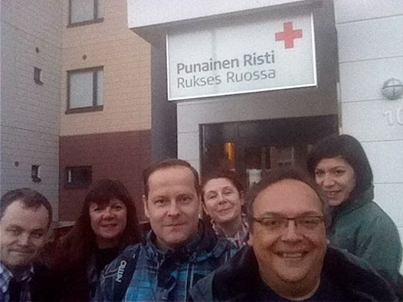
Thank You !
© 2016 of Oxford Brookes University, University of West London, Lapland University of Applied Science, Ratiu Foundation for Democracy. All rights reserved. Licenced to the European Union under condition.
Not to be cited without written permission of the authors.
Please contact Professor Simonetta Manfredi, Project Coordinator at smanfredi@brookes.ac.uk

