Slide 1
Combating Human Trafficking
Combat THB is a Project of:
This project has been funded with support from the European Commission. This publication reflects the views only of the authors, and the European Commission cannot be held responsible for any use which may be made of the information contained therein.

Slide 2
Karla’s Story
Listen to Karla’s story:

Slide 3
Karla’s Story: A Summary
Moved across the country for work
Trained by traffickers for employment
Forced to change non-commissionable reservations into commissioned reservations
Worked extra shifts and did not socialise with colleagues
Caught by hotel and reported to police
Remanded in custody as no fixed address and no means of support
Taken to court

Slide 4
What is Human Trafficking (THB)?
“the recruitment, transportation, transfer, harbouring or receipt of persons, by means of the threat or use of force or other forms of coercion, of abduction, of fraud, of deception, of the abuse of power or of a position of vulnerability or of the giving or receiving of payments or benefits to achieve the consent of a person having control over another person, for the purpose of exploitation”.
Movement
Coercion
Deception
Abuse
Control
Exploitation
Art 2, Directive 2011/36/EU; Art. 4, Council of Europe Convention on Action against Human Trafficking 2005; Art. 3 UN 2000, page 42.

Slide 5
What type of THB?
Forced prostitution
Forced /bonded labour
Forced criminality
Domestic servitude
Forced organ removal
Exploitation of children (begging, sex trade & warfare)

Slide 6
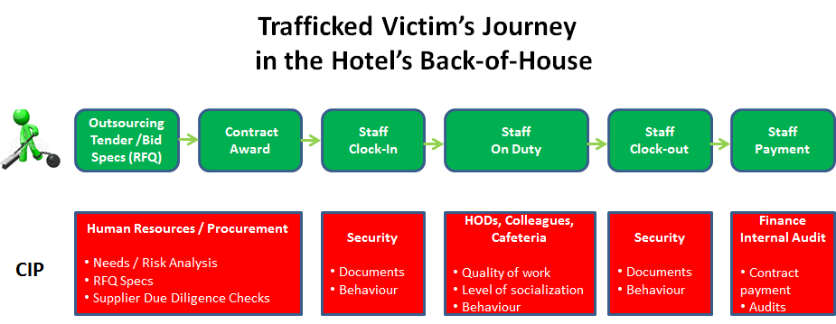
The Victim’s Journey

Slide 7
Spotting Signals
What are the signals that might have been spotted in Karla’s case?

Slide 8
Potential Signals
Arrives at work alone
Always dropped off and picked up at the same location (around the corner from the hotel)
Isolated and unwilling to socialise with colleagues
Volunteers to work during social functions
Works as much overtime as possible

Slide 9
Erecting Barriers
What procedures could have been implemented to act as barriers to this type of THB?

Slide 10
Potential Barriers
Check references when recruiting
Check address of new recruits
Check bank details of new recruits
Have colleague ‘buddy’ system for new recruits to ensure some interaction

