Slide 1
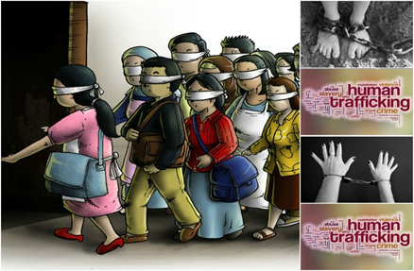
COMBAT Trafficking in Human Beings
SLIDES SUPPORTING THE REFERENCE GUIDE
FOR BOARDS, DIRECTORS AND SENIOR OFFICERS
This project has been funded with support from the European Commission. This publication reflects the views only of the authors, and the European Commission cannot be held responsible for any use which may be made of the information contained therein.

Slide 2
Combat THB: the framework
Why targeting THB?
One of the most profitable types of crime today after arms and drugs trading
An approx. US$ 150 billion business per year
2/3 of it from commercial sexual exploitation, 1/3 from forced labour exploitation
Who?
A team of 3 universities with established reputation in hospitality joined forces with a CSO with track record in the field of human trafficking prevention and assistance
Oxford Brookes University (leading partner), University of West London, Lapland Institute for Applied Science, Rațiu Foundation for Democracy

Slide 3
COMBAT THB: The Framework
Trafficking in human beings (THB) is a serious and dramatic phenomenon. Although a solid legal and policy framework has been established, THB is assuming worrying dimensions to the point of being considered as the “slavery of our times”
Recent statistics by the International Labour Organization (2012) show that the global social problem of THB is rising in Western Europe. A significant proportion of trafficking is undertaken through travel and tourism businesses which, by their nature, facilitate the movement and accommodation of traffickers and their victims. There is also evidence that tourism businesses are used for sexual and labour exploitation of trafficking victims

Slide 4
Generic info on human trafficking applicable to all levels
As a criminal activity, trafficking in human beings (THB) generates US$ 150 billion in revenue per year. Two thirds of this amount comes from commercial sexual exploitation, while the other third results from forced labour exploitation. With the hospitality industry in the EU employing some 9.5 million workers, spread out across 1.7 million enterprises, traffickers and organised criminals see an opportunity to exploit a sector perceived to be largely defenceless to, sometimes even complicit in, their activities
The nature and necessities of THB - the requirement for continuous movement, temporary accommodation, supply of low cost products and services and the privacy and anonymity offered to guests - place hospitality businesses in a high level of exposure to this criminal activity. At the same time they are also in a unique position to identify and combat it
The COMBAT training toolkit is designed to be a preventive and practical, step-by-step guide for hotel organisations to proactively fight THB. It seeks to help the prevention of trafficking in human beings in your business, to mitigate your exposure to this criminal activity and, most importantly, enable your organisation to assist the reintegration of trafficking survivors back into society
The COMBAT training toolkit is developed for three levels in tourism process (three lines of defence approach) that are operative, management and corporate levels. In this way the toolkit provides comprehensive and coherent approach that covers all main aspects in tackling against human trafficking!
See: http://www.hotrec.eu/about-us/facts-figures.aspx

Slide 5
Generic info on human trafficking applicable to all levels WHAT IS HUMAN TRAFFICKING?
The Directive 2011/36/EU of the European Union defines trafficking of human beings (THB) as:
“The recruitment, transportation, transfer, harbouring or reception of persons, including the exchange or transfer of control over those persons, by means of the threat or use of force or other forms of coercion, of abduction, of fraud, of deception, of the abuse of power or of a position of vulnerability or of the giving or receiving of payments or benefits to achieve the consent of a person having control over another person, for the purpose of exploitation”
The definition is contained in Article 2 of Directive 2011/36/EU entitled ‘Offences concerning trafficking in human beings’ and actually states that Member States are under an obligation to take the necessary measures to ensure that [the above listed] intentional acts are punishable. This definition here contained coincides with what is provided by Article 4 of the Council of Europe Convention on Action against Human Trafficking 2005
Note: Human trafficking and human smuggling are not the same phenomenon. They could be two aspects of the same offence or alternative crimes. One of the key differences between human trafficking and smuggling is that the latter always involves the illegal crossing of national borders

Slide 6
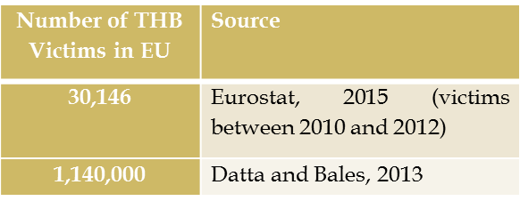
Generic info on human trafficking applicable to all levels EXTENT OF THE PROBLEM WITHIN EU
Determining the extent of (THB) is not easy for a number of reasons.
However, the problem is very wide and you may easily face it in your professional career wherever you operate!
Number of THB Victims Globally | Source
40,177 | UNODC, 2014 (victims between 2010-2012)
30,000,000 | Crane, 2013
21,000,000 | ILO, 2012

Slide 7
Generic info on human trafficking applicable to all levels FACTS AND FIGURES

Slide 8
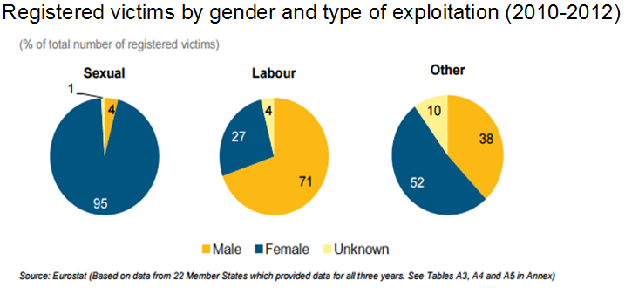
Generic info on human trafficking applicable to all levels FACTS AND FIGURES

Slide 9
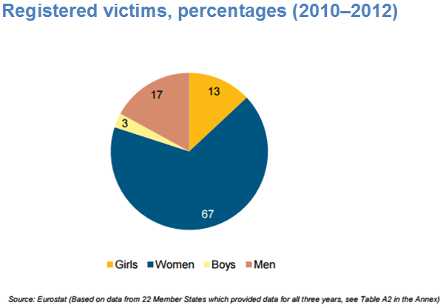
Generic info on human trafficking applicable to all levels FACTS AND FIGURES

Slide 10
Generic info on human trafficking Why tackling human trafficking is important in hospitality industry
In countries around the globe, there has been a growing focus on the use of hotels as vehicles for THB, particularly for the purposes of child sexual exploitation (CSE). Regardless of whether hotels:
Are unknowing or unwitting participants
Adopt a ‘head in the sand’ approach and ignore trafficking signs
Are willing participants who may or may not share in the trafficking proceeds
US Department of State (2015). Trafficking in Persons Report (July). [Available online: http://www.state.gov/documents/organization/245365.pdf, accessed 14 April 2016]

Slide 11
Generic info on human trafficking applicable to all levels FACTS AND FIGURES

Slide 12
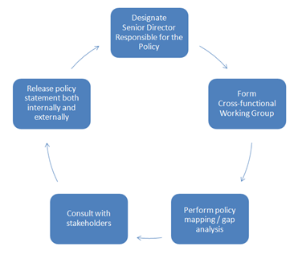
Human trafficking training for corporate level stakeholders
Steps for developing an anti-THB policy statement and programme (explain here!)

Slide 13
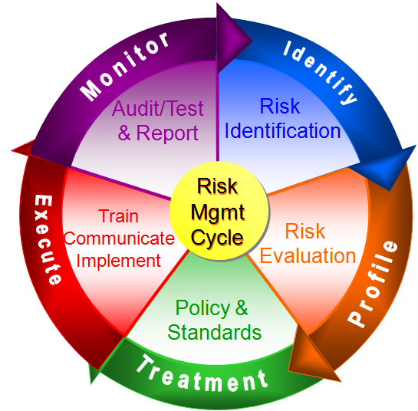
Human trafficking training for corporate level stakeholders
Risk management cycle (explain here!)

Slide 14
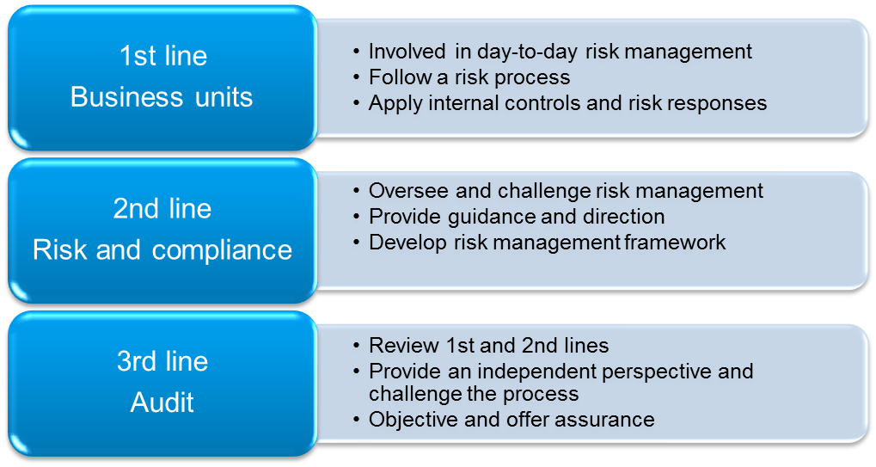
Human trafficking training for corporate level stakeholders
Three lines of defence (explain here!)

Slide 15
Human trafficking training for corporate level stakeholders
Risk assessment process:
Risk identification is the stage which aims to identify, characterise and -where appropriate- quantify a set of risks
Risk evaluation is the stage which seeks to evaluate the significance of those risks, with regards to their likelihood (probability) of occurrence and their potential impact on the organisation

Slide 16
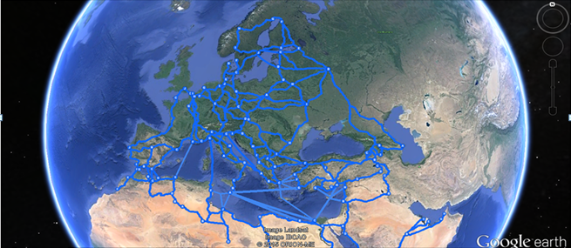
Human trafficking training for corporate level stakeholders
Trafficking Routes: EU

Slide 17
Human trafficking training for corporate level stakeholders
Why does human trafficking matter in hospitality industry?
8.2% of trafficking for sexual exploitation occurred in hotels
1.3% of trafficking for labour exploitation occurred in restaurants and bars
0.6% of trafficking for labour exploitation occurred in hotels
In Europe there could potentially be:
93,800 victims of sex trafficking in hotels
14,820 victims of forced or bonded labour in restaurants and bars
6,840 victims of forced or bonded labour in hotels

Slide 18
Human trafficking training for corporate level stakeholders
Why is the hotel industry vulnerable to THB?
Strategic
Organisational Culture
Technological
Operational
Employment Practices
Outsourcing Strategies

Slide 19
Human trafficking training for corporate level stakeholders
Why is it important to combat human trafficking hotel industry?
Legal
Ethical
Moral obligations
Extensive negative publicity
Business interruptions by law enforcement agencies or public protest
Potential criminal or civil lawsuits as identified above

Slide 20
Human trafficking training for corporate level stakeholders
The general approach to anti-THB training in a hotel organisation could be to:
Provide good quality, standard training on THB risks, awareness and reporting for all staff
Provide additional, more detailed anti-THB policies and standards training for staff in higher-risk functions (e.g., recruitment, procurement, etc.) and locations (e.g., those identified as in close proximity to those routes used by traffickers)
Ensure that staff responsible for training others have sufficient training themselves
Ensure that training offers practical examples of THB risk and covers relevant policies and standards
Test staff awareness of THB and understanding of relevant policies and use the results to assess individual training needs and the overall quality of the training
Maintain staff records setting out what training was completed and when
Provide refresher training (it should not be viewed as a ‘one-off’ event) and ensure that all training material is kept up-to-date with legislative changes, internal or external case law and sectoral or general best practice

Slide 21
Human trafficking training for corporate level stakeholders
Good practice in external reporting would be for the organisation to disclose:
How the organisation, its business and its supply chains are structured - to provide some useful context to the reader
What policies it has in place (reviewed or introduced) to combat THB - they may be stand-alone policies or elements relevant to THB in other existing policies, e.g. procurement or hiring standard operating procedures
How the ‘tone from the top’ is set
How the overall governance of the anti-THB programme is managed
How the business functions have been risk assessed for vulnerabilities to THB (this could include an assessment by region)
How direct (and indirect) supplier contracts have been reviewed
The due diligence process on new and existing strategic customer accounts and suppliers (to show a thorough understanding of who the company is dealing with and who is working for them, e.g. through supplier audits)
The metrics used to assess the effectiveness of the anti-THB programme – e.g. specific KPIs
Who has been trained and how )e.g. target audience, key employees trained, training offered to strategic customers and/or suppliers, range and forms of training, etc.)

Slide 22
Human trafficking training for corporate level stakeholders
Monitoring anti-THB-activities – why it is important?
An effective anti-THB programme must be able to work in practice. It is a key management responsibility to monitor its effectiveness in preventing and/or mitigating the risk of THB throughout the business functions of the organisation as they evolve with the changing environment
Reports for internal stakeholders may include:
Periodic updates for the Board on the status of implementation of the anti-THB programme
Reports summarising internal audit and/or compliance monitoring findings
Reports of any alleged or actual breaches and the scope and findings of any investigation

Slide 23
Why it is important to communicate about THB?
An enhanced level of awareness of front- and back-of-the-house THB risks amongst all employees
Sensitivity to these risks across the organisation with effective monitoring and reporting of possible signals (red flags)
The ability of operational management to invoke the relevant incident management procedures, when appropriate

Slide 24
The general approach to anti-THB training in a hotel
Provide good quality, standard training on THB risks, awareness and reporting for all staff
Provide additional, more detailed anti-THB policies and standards training for staff in higher-risk functions (e.g., recruitment, procurement, etc.) and locations (e.g., those identified as in close proximity to those routes used by traffickers)
Ensure that staff responsible for training others have sufficient training themselves
Ensure that training offers practical examples of THB risk and covers relevant policies and standards
Test staff awareness of THB and understanding of relevant policies and use the results to assess individual training needs and the overall quality of the training
Maintain staff records setting out what training was completed and when
Provide refresher training (it should not be viewed as a ‘one-off’ event) and ensure that all training material is kept up-to-date with legislative changes, internal or external case law and sectoral or general best practice

Slide 25
Develop partnerships!
Increasingly stakeholders put pressure on corporate boards to move beyond mere policy statements and develop partnerships and networks with other businesses and organisations in order to combat THB at a global, regional and local level
Case: Oxford Hotel Watch, ‘Say Something if you See Something’

Slide 26
How to act with victim if you face victim?
Advice and guidance to help to develop appropriate organisational policies
Staff training and updates on anti-trafficking legislation, prevention and awareness campaigns
Support and guidance when a trafficking incident occurs
If your staff faces victim case:
Emotional and psychological support for victims, which can make a tremendous difference
Interpreters to help victims overcome language barriers
Access to food and clothing for victims
Advice for victims on rebuilding their lives; e.g. on immigration laws, accommodation, personal finance, access to healthcare, language lessons and employment
See and contact: NGO’s in operation!

Slide 27
Annex: legislative framework
The human trafficking legislative framework in Europe is characterised by a variety of provisions, which encompass International Conventions (such as the 2000 UN Convention against Transnational Organized Crime, and 1930 ILO’s Convention No 29 concerning Forced or Compulsory Labour) and two overlapping regional instruments (the 2005 Council of Europe Anti-Trafficking Convention (CAT) and Directive 2011/36/EU)
The Council of Europe Anti-Trafficking Convention (CAT), adopted in 2005, serves the purpose of combating and preventing THB imposing a number of obligations on the Council of Europe’s contracting parties
The Directive 2011/36/EU introduced in 2011 serves the purpose not only to combat trafficking crimes but also to provide suitable support for victims. It sets out that human trafficking is a criminal offence. Also inciting, aiding, abetting and attempts to commit human trafficking are considered as wrongdoings and are punishable (Article 3 Directive 2011/36). This legal instrument imposes an obligation on the EU Member States to set up criminal procedures to investigate offences and to prosecute offenders
The provisions of the European Directive have been incorporated into national legislation. If Member States do not comply with the Directive the Commission is competent to enforce European law bringing non-compliant Member States before the Court of Justice of the EU (CJEU). The Court has the power to condemn infringing States, fining them for non-compliance. Such a mechanism is essential to ensure compliance and effectiveness of EU law across all Member States
There is a separate legal definition about smuggling of migrants. Article 3 (a) of the Smuggling of Migrants Protocol provides that the term smuggling of migrants means “the procurement, in order to obtain, directly or indirectly, a financial or other material benefit, of the illegal entry of a person into a State Party of which the person is not a national or a permanent resident”
Continued…

Slide 28
Annex: legislative framework
United Nations Convention against Transnational Organized Crime which includes a Protocol to Prevent, Suppress and Punish Trafficking in Persons, Especially Women and Children and a Protocol against the Smuggling of Migrants by Land, Sea and Air. [Available at:
https://www.unodc.org/documents/middleeastandnorthafrica/organised-crime/UNITED_NATIONS_CONVENTION_AGAINST_TRANSNATIONAL_ORGANIZED_CRIME_AND_THE_PROTOCOLS_THERETO.pdf accessed on 20th January 2016].
International Labour Organization (ILO)’s Convention No 29 1930 concerning Forced or Compulsory Labour available at http://www.ilo.org/dyn/normlex/en/f?p=NORMLEXPUB:12100:0::NO::P12100_ILO_CODE:C029
European Commission, 31st Annual Report on Monitoring the Application of EU Law (2013) Brussels, 1.10.2014 COM(2014) 612 final, [Available at http://ec.europa.eu/atwork/applying-eu-law/docs/annual_report_31/com_2014_612_en.pdf accessed on 26 July 2015].
Smuggling is covered by the 2000 Protocol against the Smuggling of Migrants by Land, Sea and Air Supplementing The United Nations Convention Against Transnational Organized Crime (entered into force on 28 January 2004). [Available at http://www.unodc.org/documents/southeastasiaandpacific/2011/04/som-indonesia/convention_smug_eng.pdf accessed on 26 July 2015].
Ibid at Article 3 (a)

Slide 29
Annex: Useful links
http://www.osce.org/secretariat/trafficking
http://www.brookes.ac.uk/microsites/combat-human-trafficking/
www.thecode.org
https://www.change.org/p/stop-wyndham-hotel-staff-from-supporting-child-sex-trafficking-in-wyndham-hotels
http://www.hotelnewsnow.com/Articles/11778/Hotels-are-hub-of-human-trafficking-prevention
www.gbcat.org
http://tourismpartnership.org/wp-content/themes/itp-child/assets/files/ITP-Human-Trafficking-Position-Statement.pdf
https://www.youtube.com/watch?v=Z_OFnglL-dI
https://endslaveryandtrafficking.org/
http://www.gbcat.org/
http://tourismpartnership.org/human-trafficking/
http://www.banburyguardian.co.uk/news/local-news/bullfinch-senior-police-officer-talks-about-tackling-cse-in-cherwell-1-6611095
http://www.redcross.eu/en/What-we-do/Asylum-Migration/Red-Cross-Networks-on-migration/European-Anti-Trafficking-Network/
http://www.antislavery.org/english/?pr=
http://www.ecpat.org.uk/
http://www.payoke.be
http://www.youthcareerinitiative.org/chung-vietnam-2014-15/
http://www.freetogrow.com/programmes
http://www.globalfundforchildren.org/a-tale-of-a-survivor-of-commercial-sex-trafficking/

Slide 30
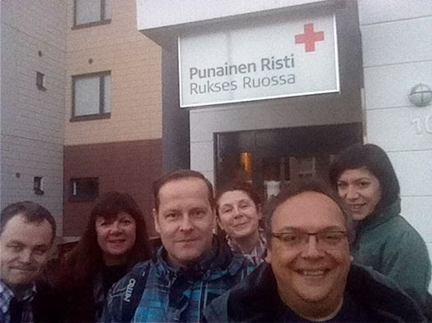
Thank You !
© 2016 of Oxford Brookes University, University of West London, Lapland University of Applied Science, Ratiu Foundation for Democracy. All rights reserved. Licenced to the European Union under condition.
Not to be cited without written permission of the authors.
Please contact Professor Simonetta Manfredi, Project Coordinator at smanfredi@brookes.ac.uk

